Slide 1
Pervasive Computing
Establishing the relationship between pervasive computing and Artificial Intelligence
Human-Computer Interaction
Master’s Degree in Artificial Intelligence
Spring Semester
2022-23

Slide 2
Introduction
Pervasive computing and Artificial intelligence are closely related in that they both involve the integration of technology into our daily lives.
Pervasive computing → Focused on creating a network of devices and services that are always available and always connected.
Artificial Intelligence → Concerned with the development of machines and software that can perform tasks that would normally require human intelligence.
Pervasive computing + Artificial intelligence
=
Intelligent environments that are aware of the people and objects around them, and that can interact with them in useful and meaningful ways.

Slide 3
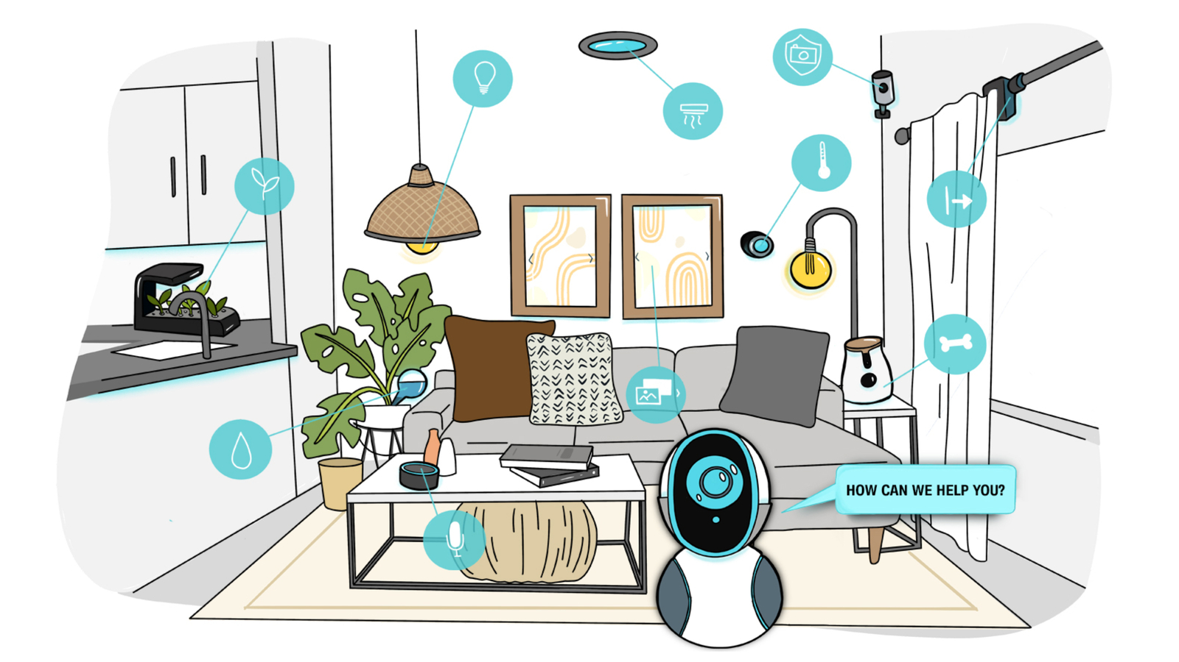
Example: A Smart Home
A smart home that uses pervasive computing technology could be equipped with AI-powered virtual assistants that can respond to voice commands, adjust the temperature based on individual preferences, and even order groceries online.

Slide 4
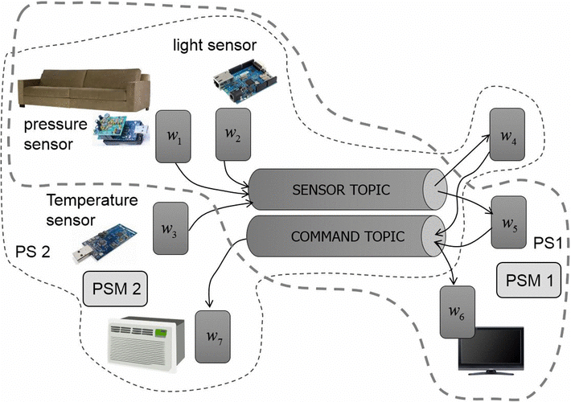
Example: A Smart Home
Pervasing Computing
Pervasive computing’s Role: underlying infrastructure and connectivity necessary to enable devices to communicate with one another.
Control of lighting, temperature, and other environmental factors via sensors and connected devices
Home security and monitoring, including cameras, motion detectors, and door locks
Energy management, including monitoring and controlling the use of electricity, gas, and water
Entertainment and media systems, including music and video streaming and home theater integration

Slide 5
About Pervasing Computing
Its realization : Internet of Things (IoT) → The connecting of different systems allowed the exchange of data between devices
Pervasive Computing systems are designed in a way that it is meeting requirements and needs of different types of users and for specific purposes. Then Pervasive Computing makes devices and systems more available, convenient and easy of use, when the users are in front of a complex technology. So it’s all about those fundamentals paradigms :
Decentralization
Diversification
Connectivity
Simplicity

Slide 6
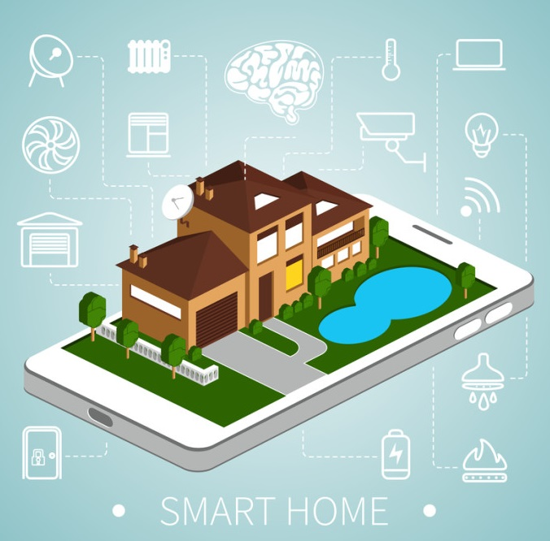
Example: A Smart Home
Artificial Intelligence
AI’s Role: make sense of the data generated by the pervasing computing devices and enable more sophisticated interactions with the environment.
Personalized user interfaces that adjust to individual preferences and habits
Voice assistants that can control devices and respond to questions and commands
Predictive maintenance of appliances and systems to prevent breakdowns and reduce maintenance costs
Energy optimization based on patterns of usage and occupancy

Slide 7
About Artificial Intelligence
Machine Learning → A branch of AI, that represents the use and development of computer systems that are able to learn and adapt without following explicit instructions, draw inferences from patterns in data - Imitation of the intelligent human behavior
Natural Language Processing (NLP) → Processing and understanding the human language so they can automatically perform specific tasks → For example Personal AI Assistant (Alexa, Google…) that uses
Deep Learning → A type of Machine Learning based on artificial neural networks, which process higher level features from data, to reproduce complex tasks
Segmentation, Classification → For example, facial recognition, or personalized recommendations

Slide 8
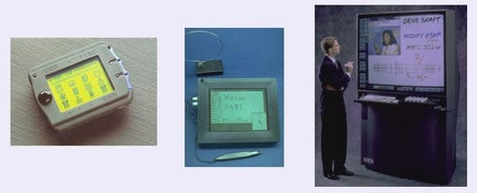
AI and Pervasive Computing - 1
Mark Weiser, the father of pervasive computing, proposed 3 basic forms of ubiquitous computing devices:
tabs: wearable devices (size ~ 1cm)
pads: hand-held devices (size ~ 1dm)
boards: interactive larger display (size ~ 1m)
From 1988 many and more innovative ideas have been proposed, but despite how we want to think about it, an IoT ecosystem consists of using these web-enabled devices to collect, analyze, and send data from the environment to the user, and vice versa.
“Ubicomp is a concept in software engineering and computer science where computing is made to appear anytime and everywhere.”

Slide 9
AI and Pervasive Computing - 2
Beside IoT, a network of data - Big data → AI adds up a new dimension of network to consider in the Pervasive Computing systems, which not only communicate through an internet network (local or global) but also through a network of data, that is collected and used in the improvement of those systems
With the constant grow of the Artificial Intelligence field, all the systems gets to fulfill those principles fundamentals for Pervasive Computing :
Decentralization and Connectivity → Through the network of data, but also through the easiness of implementation
Diversification → Learning new functionalities and implementing new improvements through the data collected through the environment and interactions
Simplicity → The reproduction of human behavior eases the interaction between the machine and the human, making it more efficient and intuitive
Overall, AI adds a dimension of “human intelligence” in the systems used

Slide 10

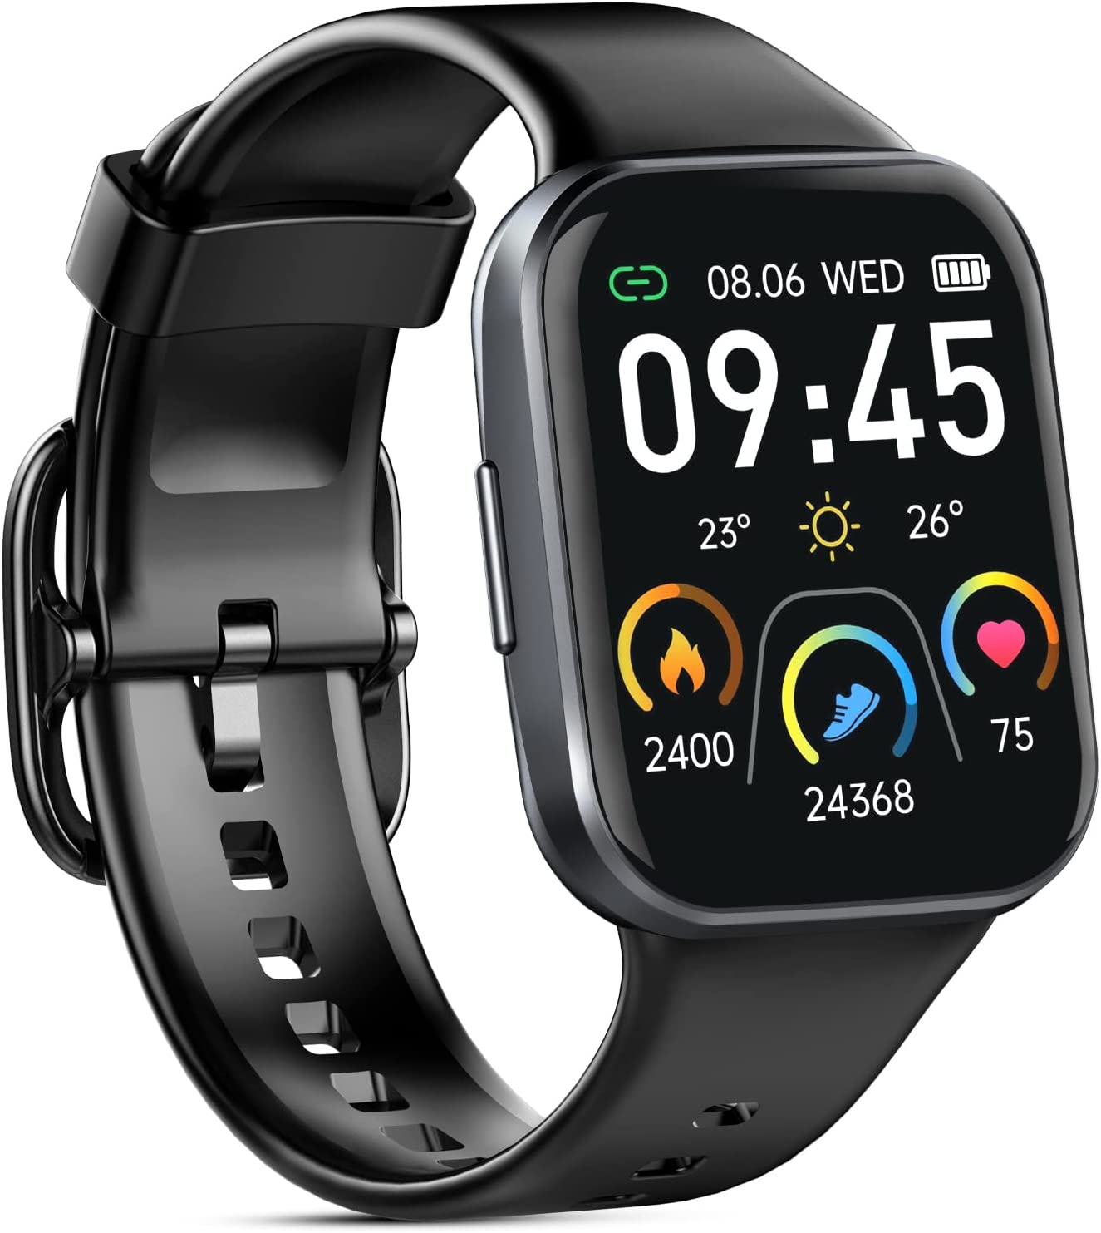
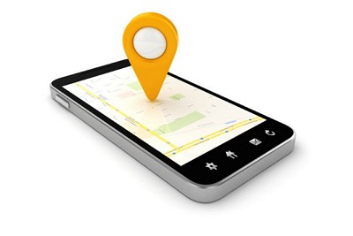
AI and Pervasive Computing - 3
Hearables and wearables: to improve the performance of a training session (e.g., for a runner or cyclist). By monitoring the athlete’s conditions at any time, such devices are able to communicate coaching information via audio or video. This is possible only thanks to AI, which allows to analyze and predict the best recommendation at each instant based on data the device is collecting.
Improvement in the workplace with AI: Applying AI to devices allows for operating more efficiently, better understanding of the customers, reduce risks, and so on. For instance,, the devices can use AI and real-time data to send an alert when they detect an emergency.
GPS: can be used to locate employees’ positions but also to set secure safe zones and warn agents who breach them, so to keep them at a safe distance from dangerous areas.

Slide 11
Advantages of Pervasive Computing + AI
Improved efficiency
Personalization
Enhanced safety
Better decision-making
Cost savings
Improved accessibility
Environmental benefits
Notes:
Improved efficiency: automatization of tasks & productivity
Personalization:better customer experience and satisfaction
Enhanced safety: transportation, healthcare, or home security.
Better decision-making: AI can analyze vast amounts of data and provide insights that can help decision-makers make better-informed decisions.
Cost savings: automating tasks, reducing errors, and improving efficiency.
Improved accessibility: Pervasive computing and AI can improve accessibility for people with disabilities, such as through the use of assistive technologies and smart homes.
Environmental benefits: optimize energy use, reduce waste, and improve sustainability.
As these technologies continue to advance, we can expect to see even more significant benefits in various domains.

Slide 12
Challenges of Pervasive Computing + AI
Data privacy and security
Bias in AI
Job displacement
Ethical dilemmas
Integration with existing systems
Lack of standards
Human-machine interaction
Notes:
Data privacy and security: With the widespread use of sensors and connected devices in pervasive computing, there is a massive amount of data generated, raising concerns about privacy and security breaches. Similarly, AI requires vast amounts of data to be trained, which also raises concerns about privacy.
Bias in AI: Artificial intelligence systems are only as good as the data they are trained on. If the data is biased or incomplete, the AI system can make biased decisions or predictions, leading to unfair treatment of certain groups or individuals.
Job displacement: Pervasive computing and AI have the potential to automate many jobs that are currently done by humans, leading to job displacement and unemployment.
Ethical dilemmas: Pervasive computing and AI can raise ethical dilemmas, such as how to program self-driving cars to make ethical decisions in life-or-death situations, or how to ensure that AI-powered decision-making is transparent and accountable.
Integration with existing systems: Pervasive computing and AI often require integration with existing systems and infrastructure, which can be costly and time-consuming.
Lack of standards: There are currently no global standards for pervasive computing and AI, making it challenging to ensure interoperability and consistency across systems.
Human-machine interaction: As AI becomes more prevalent, there are concerns about how humans will interact with intelligent machines and how to ensure that AI is used to enhance human capabilities rather than replace them. Addressing these challenges requires a collaborative effort among policymakers, industry leaders, and researchers to develop ethical frameworks, privacy regulations, and standards that can guide the development and deployment of these technologies. It is critical to ensure that these technologies are developed and deployed in a way that maximizes their benefits while minimizing their potential negative impacts.

Slide 13
Is Computing Awareness the only possible approach?
Computing awareness → Devices and systems that are aware of their surroundings and can adapt to changes in the environment. This approach is based on the idea that pervasive computing systems should be able to sense and respond to the physical world in the same way that humans do.
Edge Computing → Devices process data and analyze them on devices at the network edge instead of centralizing the data to a server, which can increase the efficiency of computation. (like in smart homes and autonomous vehicles)
Swarm Intelligence → Inducing multiple devices or agents to work together to solve complex problems (Multi-Agent system)
Wearable Computing → Taking Computing awareness to the next level by allowing them to be not only closer to the goal environment, but also to users themselves (smartwatches, augmented reality, personalized health monitoring… )

Slide 14
Is Computing Awareness the only possible approach?
An alternative: Proactive computing
Proactive computing → Involves anticipating user needs and providing assistance before it is requested.
While Pervasive Computing and Computing awareness are more based on the present utilization of the devices, the Proactive one is taking into consideration the past utilization and the present one to anticipate user needs that comes in the near future, before the users even ask for it.
Therefore, it takes more into account the prediction functionality of AI
Example : Autonomous cars

Slide 15
Conclusion
If you have any questions, we’ll be happy to answer them.
Human-Computer Interaction
Master’s Degree in Artificial Intelligence
Spring Semester
2022-23

